Slide 1

Meet the Headteacher
7th January 2026

Slide 2


Slide 3
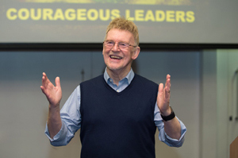
‘The job of a teacher is to weave magic.
We are in the magic weaving business!’
Sir John Jones

Slide 4


Slide 5

About me
School leader for over 10 years
Strengths
Relationships
Curriculum Design
Behaviour
High Expectations
Community spirit
Extra curricular
Getting children ready for the next phase of their educational journey

Slide 6
What to expect from me?

Slide 7

Respect and Kindness at Steeple Claydon
Treating each other as you want to be treated – adults and children
School rules are there to keep everyone safe
Trying your best
Accepting help
Classroom and Playground
*This includes adults*

Slide 8

Opportunities
Music
Sport
Charities
Drama
Leaders
Secondary schools
MK Dons – Already!
What do you remember about school?

Slide 9
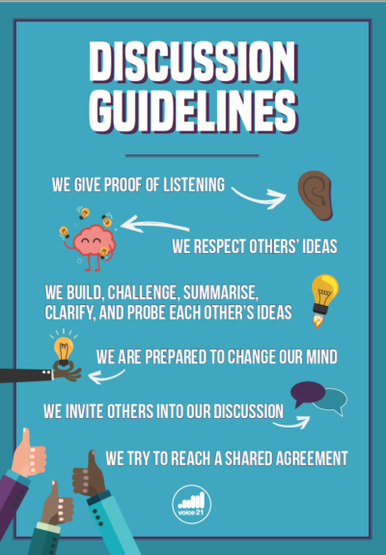
Oracy and confidence
Children will be heard
They will be encouraged to share their opinion
They will be taught social skills
Listening Skills
Linked to respect – they will debate
They will speak in public

Slide 10

Safeguarding, Behaviour and Attendance
Number one priority
Each child will know who to talk to
Guidance will be current and relevant.
Behaviour policy will remain positive.
Poor behaviours and mistakes will have consequences and opportunities to reflect.
Attendance will remain a priority – 32 children were considered persistently absent in the Autumn term.
Without the attendance – we can’t do the fun.

Slide 11

Promoting the school
Social Media to remove ‘that moment’ on the walk home.
Online groups
Local press
Opportunities for you to be in the school

Slide 12

Curriculum and Assessment
Building and adapting on PKC
Encouraging creativity
Improved outcomes
Getting the children to do more – awe and wonder
Children leaving school best prepared for Secondary.
We don’t know the world they are going to need to be ready for – skills!

Slide 13

Modernising
Website
Newsletter
Comms – new MIS format
Social Media
OPAL
Site

Slide 14
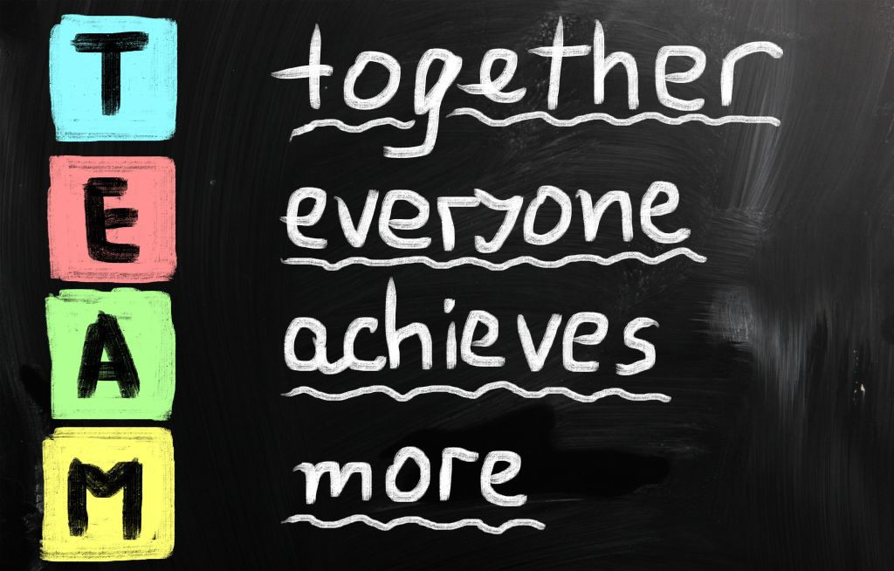
We need your help
Children are at school for 7 hours a day and at home 17 hours (yes a lot of that is sleeping)
High expectations
Home Learning.
Be Curious
Trust and support
FOSCS
FUDGE – I need you!
Amazon Wishlist

Slide 15


Slide 16


